Slide 1
CASE STUDY ON FISH FARMING IN NIGERIA
NATIONAL CENTRE FOR WOMEN DEVELOPMENT ABUJA

Slide 2
Table of Content
Introduction / 3
Types of Fish Farming (Fish Species) /4
Production Cycle of CatFish (Clarias gariepinus) /5
Weighing the Gravid Female Fish /6
Benefits of Fish Farming /7
Feeds: Feeding of Fish, In a Fish Farming system / 9
Two Types of Fish Feed / 10
What are the Sizes Of Feeds For Your CatFishes /11
How Often Should You Feed Your Fishes? /12
Buying Catfish Feed vs. Making Your Feed /13
Building of Fish Ponds For Fish Farming /14
Risks and Challenges in Fish Farming In Nigeria /15
What You Need to Get Started In Fish Farming /16
Feasibility Study for Standard Fish Farming /17

Slide 3
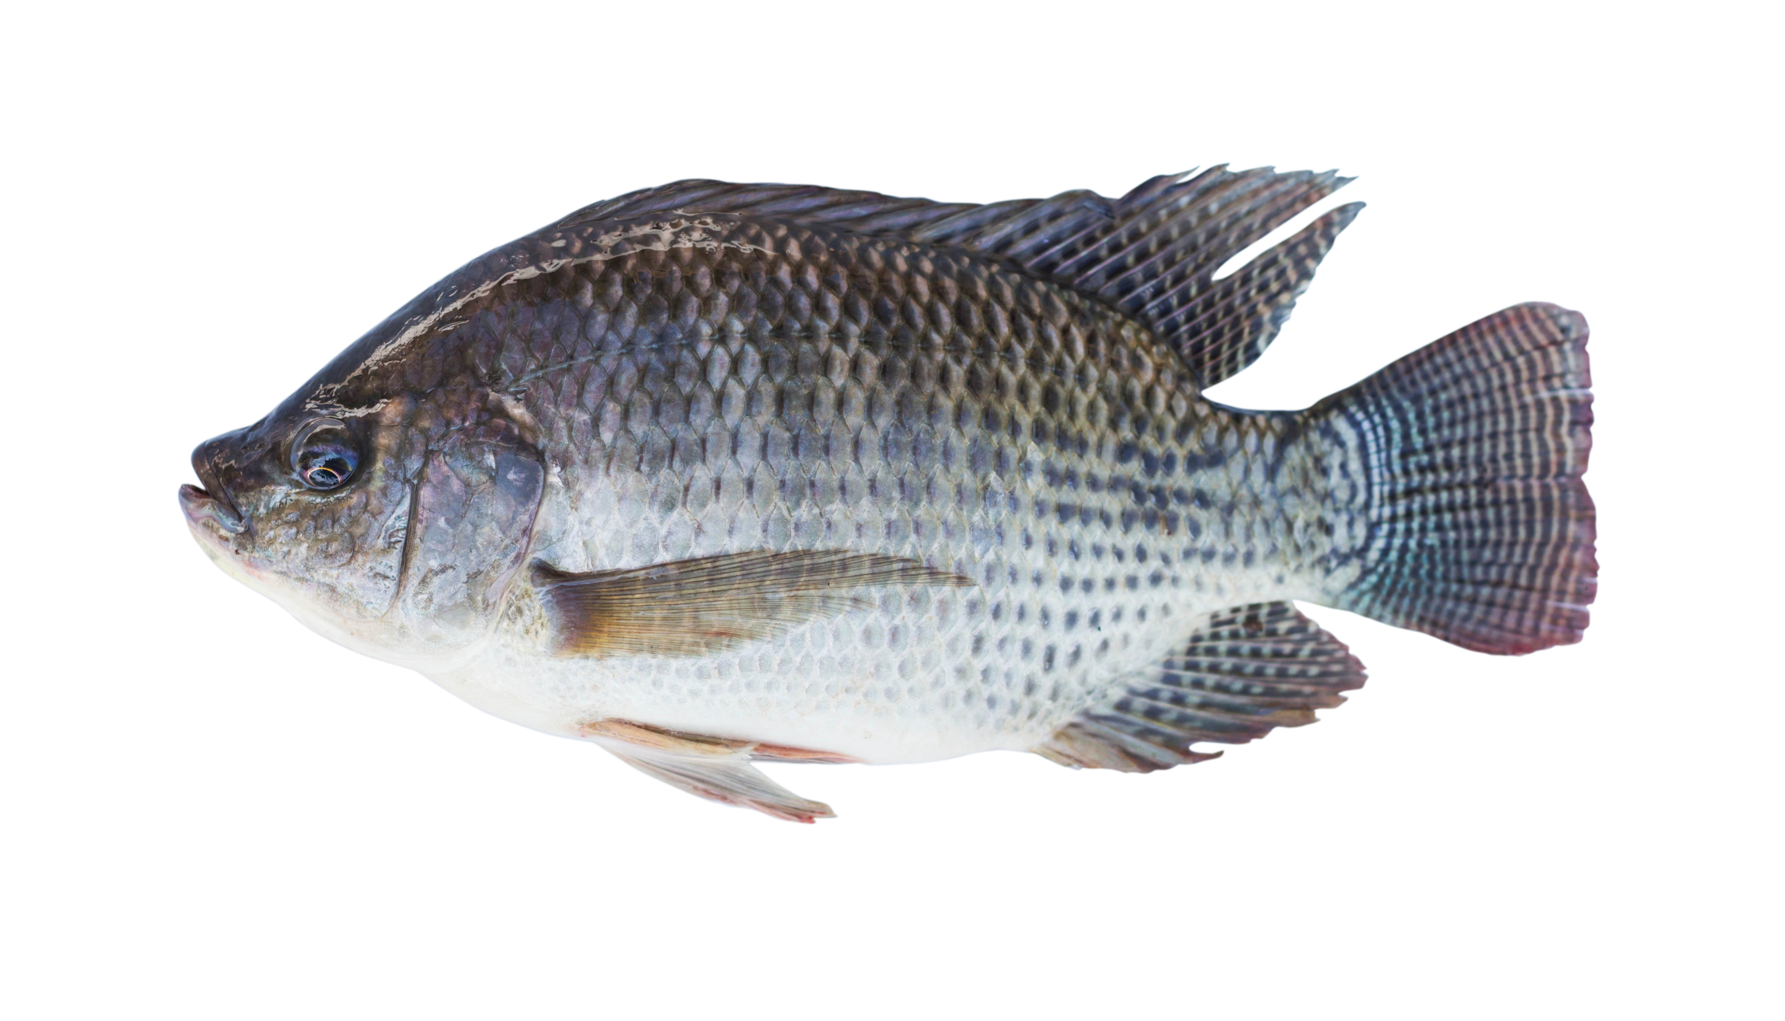
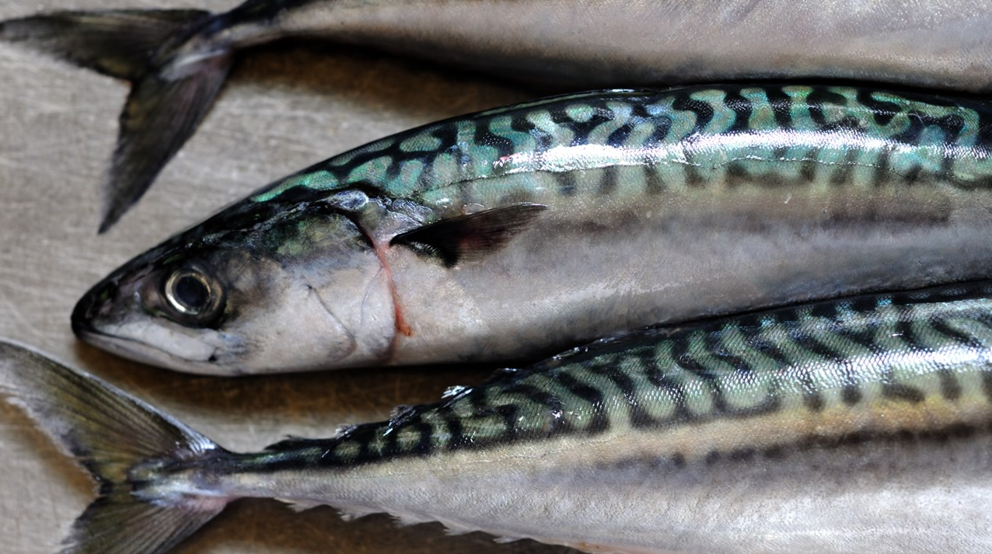
INTRODUCTION
Aquaculture is an industry that is currently attracting investors due to its lucrative nature, fertile land for fish, high demands for fish and the low supply in the country.
To make it in this business, it requires having the right knowledge and proper management skills. With these, high-profit margins are achievable and ensured in this business.
The fish farming system is the system in which fishes are reared for sale or for consumption. In other words, fish farming entails breeding of different varieties of fishes such as Catfish, Tilapia and Mackerel (Tilapia) etc.
Fish farming is a knowledge-driven sector, and this underscores the importance of training
Cat Fish
Tilapia Fish
Mackerel Fish

Slide 4
Types of Fish Farming (Fish Species)
There are varieties of fishes that exist, but only a few of these fishes can be breed.
There are basically three major fish species that farmers breed on fish farming- a) Catfish Farming b)Tilapia Fish Farming c)Mackerel Fish Farming (Titus)
1.Catfish-
Catfish species is by far the most cultivated in Nigeria. One major attractive part of this species of fish is that it is one of the easiest species to breed. Catfish farming can be categories into two parts, nursery fish farming and the grow out fish farming. The nursery fish farming system involves the inducement of the female fish to lay eggs, which are then fertilized, incubated and hatched into little fishes known as ‘Fries’.
These Fries are nurtured into fingerlings within a month.
Thereafter the fingerlings will be moved into a grow out structure.
The primary operation lies between the nursery and grows out, and it involved the nurturing of the four weeks, within which they grow into post fingerlings, mini-juvenile, and juveniles.
2. Tilapia –
Second most popular fish in Nigeria’s aquaculture industry, Tilapia is a fish species that lives in fresh shallow water. Tilapia is very easy to cultivate and very popular in Nigerian market, it reproduces very rapidly and grows fast too.
3. Mackerel (Titus) –
This is by far the most popular fish in Nigerian market but so sad it’s not farmed. All Mackerel Fish are “wild caught” but some farmer in Nigeria are considering the possibility of creating artificial salty water that will be similar to sea water where mackerel can only survive.

Slide 6
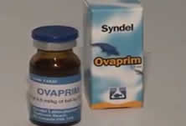
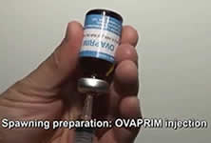
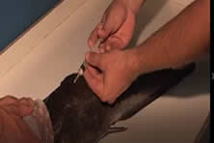
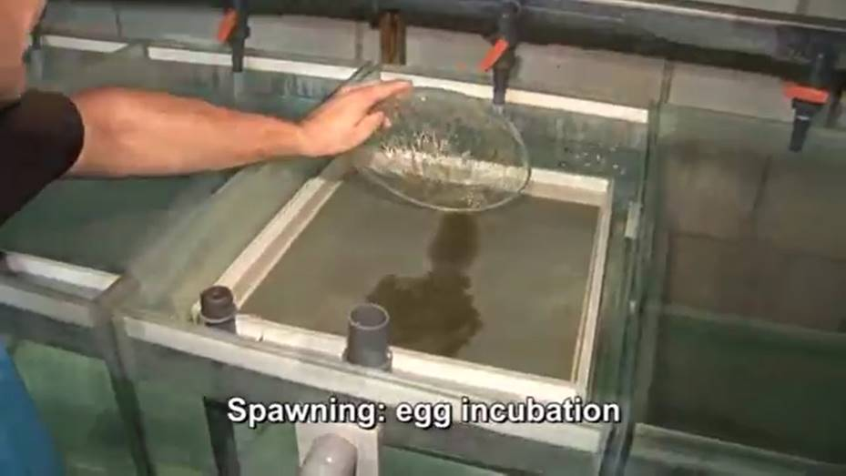
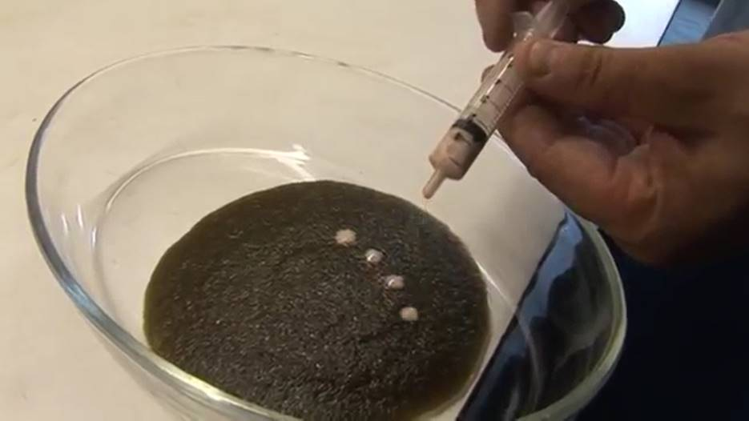
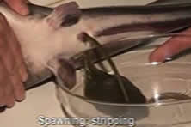
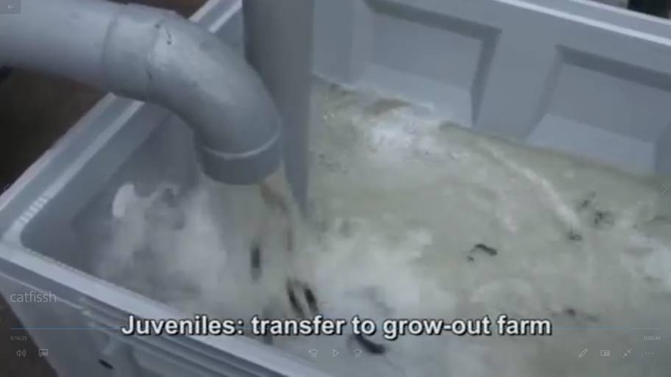
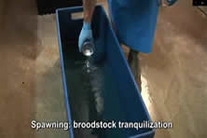
Production Cycle of CatFish (Clarias gariepinus)

Slide 7
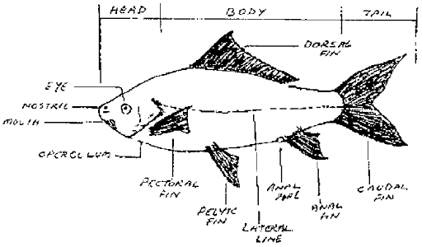
.

Slide 8
Benefits of Fish Farming
1. Fish is Popular
Fishery products are by far the most popular animal products in the market, constituting more than 60% of meat products in the Nigerian market.
2. Fish is Source of Protein
Fish provides one of the highest sources of protein. It is a low-fat high-quality protein that is filled with omega-3 fatty acids and vitamins such as D and B2 (riboflavin). Fish is also very rich in calcium and phosphorus and is equally a great source of minerals, such as iron, zinc, iodine, magnesium, and potassium for the body.
3. Fish Sells Quick
Fish is a hot commodity in the market. Fish sells faster than any other animal products in the market and is relatively cheaper than meats, making it the number one choice when it comes to affordability.
4. Fish Matures Quickly
If proper steps and processes are taken fish grows rapidly. Fish grows very fast as practices in fish farming make it possible for farmers to increase the fastness of their fish growth by giving them certain feeds, ensuring that you harvest and sell within the short period of time.

Slide 9
Benefits of Fish Farming
5. Fish Contains Omega-3
The best provider of Omega-3 acid is the proper consumption of fish. Fish is the biggest source of Omega-3 fatty acids which is extremely beneficial to a human heart; Omega-3 helps to keep our heart and brain very healthy. Since the human body doesn’t produce Omega-3 fatty acids, the only source through which we can get it is by what we eat, that is where fish comes to the rescue.
6. Fish Farming is Profitable
Fish farming is very profitable. With proper planning and good management, you can make a huge profit from fish farming.
7. No Environmental Hazard
Fish farm does not cause any environmental hazard. Unlike poultry farming, you can set up the fish farm anywhere, including residential areas. If you have a spacious compound, you can easily set up a small fish farm within your backyard without any regulatory precaution.
8. Compatibility with Poultry Farming
Fish farming (especially catfish) is the most compatible with the poultry farming system in Nigeria, as you can use the poultry drops to facilitate the production of the feed for your fish.

Slide 10
Feeds: Feeding of Fish, In a Fish Farming system
The feeds and feeding of fish farming are different, the feeding is categorized into two.
Types of Feeding for Fishes:
Basically, the analysis below will show the different types of feeding for Catfish, - Here are the two types of feeding Broadcast Feeding and Spot feeding.
Broadcast Feeding: This basically involves going around the ponds by spreading floating feed all over the pond to ensure the circulation of feeds for all the fishes in the pond.
This is the easiest ways for fishes if they are in the fingerlings to the post-juvenile stage.
This should be done because they just got introduced into a large quantity of water, often from somewhere significantly smaller, and not all the fishes can come to the same spot to eat.
By spreading the extruding (or floating) feed across the pond, it will ensure they all get to eat.
Once your fishes become more mature, often this is in the post-juvenile stage or around 30 – 50 grams, you are advised to instantly switch to spot feeding.
Spot Feeding: Spot feeding is less time-consuming and it’s more effective since it is less stressful and you can carefully monitor how your fishes are eating.
Spot feeding is basically the feeding of your fishes in one single spot.
At first, if they are used to eating using the broadcast style, most of the fishes won’t come to a particular spot to eat; however, by only feeding them on that spot for a few days, they’ll be conditioned to come to that spot and eat.
Farmers should condition the fishes to eat in one spot once they reach 30 – 50 grams, or after 2 – 3 weeks of stocking them from a juvenile stage.

Slide 11
Two Types of Fish Feed
Since there are different stages of catfish growth, there are different stages of fish feed; the fish feed is often denoted in mm, hence, you’ll see/hear about 1.5mm feed, 1.8mm feed, 2mm feed, 4mm feed, 6mm feed etc. These are the mainly 4 types of catfishes:
• Fingerlings (3 to 4 grams)
• Post-fingerlings (4 – 6 grams)
• Juvenile (6 – 10 grams)
• Post-juvenile (10 grams and above)
Also, there are two types of Fish Feed, they are Extruded(Floating) and the non-Extruded(sinking) feed.
Extruded Feed (Floating)
The Extruded feed is also referred to as a Floating feed. This type of feed is the early fish feed given to fish in their early stage. This is the best feed for fishes for 7-8 weeks.
It is recommended giving Catfishes floating feed at the early stage because they are more fragile at their early stage. Catfishes are mostly bottom feeder, so by their very nature, they are designed to be eating non-extruded (or sinking) feed.
With floating feed, you can put the feed on the pond gradually and let them eat it; the risk of overfeeding is significantly reduced, thereby ensuring there is no water pollution that can lead to high mortality in the very fragile juveniles.
Furthermore, due to their fragile nature, giving the juveniles feed that isn’t rich and not containing the right nutrients can affect their long-term growth.
Non-Extruded Feed (Sinking)
The Non- Extruded feed is also referred to as a Sinking Feed. This type of feed is the employed feed after the 8 weeks of feeding your fishes with Floating (Extruded) feed.

Slide 12
What are the Sizes Of Feeds For Your CatFishes
Suitably recommendation recommends if you just stocked your ponds, fishes that fall into the following listed categories:
Fingerlings (3 to 4 grams): 1.5mm feed size
Post-fingerlings (4 – 6 grams): 1.8mm feed size
Juvenile (6 – 10 grams): 2mm feed size
Post-juvenile (10 – 50 grams): 2mm feed size
As your fishes grow, the size of feed they can pick will increase. Here are the recommended sizes for bigger fishes, based on their size/weight if you’re to give them floating feed:
10 – 50 grams: 2mm feed size
50 – 150 grams: 3mm feed size
150 – 400 grams: 4mm feed size
All things being equal, your fishes should be around 200 – 300 grams in 2 months with floating feed alone, if they are being fed properly; after then, you can switch to sinking feed and give them the following feed sizes:
200 – 300 grams: 2mm feed size
300 to 600 grams: 4mm feed size
600 grams to 1kg+: 6mm feed size
If your fishes exceed 1kg in weight, and you’re able to get bigger feed sizes, then you can consider giving them 8mm, or even later 10mm, feed sizes. 3 to 4kg fishes eat 6mm sinking feed is just fine.

Slide 13
How Often Should You Feed Your Fishes?
How often you feed your fishes will differ depending on a lot of factors, but to realize an average of 1.5kg to 2kg fish size in 6 months – here’s what I recommend:
Fingerlings (3 to 4 grams): twice daily
Post-fingerlings (4 – 6 grams): once or twice daily
Juvenile (6 – 10 grams): once or twice daily
Post-juvenile (10 grams and above): once daily
Anything above post-juvenile: once daily

Slide 14
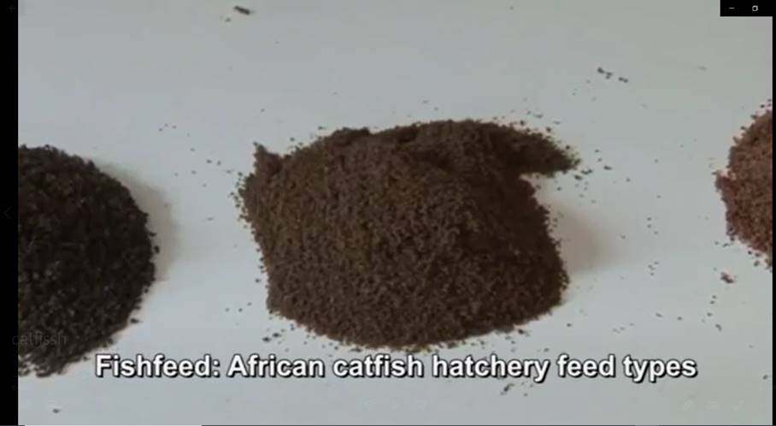
Buying Catfish Feed vs. Making Your Feed
It is more profitable if you make your own feed as opposed to buying feed from major producers.
That said, I recommend buying feed from feed producers like Raanan or Aqua Feed until your fishes reach 200 – 300 grams, and then giving them local feed.
Protein is the main ingredient in fish feed, and every good feed formula contains a significant amount of protein; however, fishes still need energy, mainly found in carbohydrate, to process and digest the feed.
Feed Formula for 200 – 600 Grams Catfish
Fish meal (Hanstholm, 72%): 25%
Soya Meal (or full fat soya): 30%
GNC (Groundnut cake): 20%
Dough/Maize/Biscuit (or other main forms of energy/carbohydrate): 20%
Molasses: 5%
(Based on this formula, 1 ton of fish feed will have: 250kg fish meal, 300kg soya meal, 200kg GNC, 200kg Dough, 50kg molasses)
The above are the main ingredients; you can then use other ingredients such as DCP (Dicalcium Phosphate), Methionine, Lysine, Salt, Vit. C, Fish Premixes, Antibiotics, etc. according to your preference.

Slide 15
Building of Fish Ponds For Fish Farming
Fishponds is referred to as an artificial fish ponds, it is a great alternative to natural water reservoirs, in which fish can be breed is in a controllable environment.
There are two main types of artificial fish ponds: concrete and earth. Nevertheless, fish can also be bred in plastic, fibreglass or wooden reservoirs.
Construction of an earthen Pond
Construction of an earthen pond is a process that involves the digging of a hole in the ground, which is about 1m deep at the shallow end and 2m deep where the fish is bred. There are no specific demands for the design of such ponds. You can make them whatever you like providing they meet all the needs of fish.
Typically, earthen ponds are round or square but you are free to choose any shape you like. You should be sure to have had a stable clean water supply that connects to the pond.
Concrete fish pond
Concrete fish pond construction in Nigeria is not much different from the same process anywhere else in the world. You will need several blocks and some cement in order to construct thicker walls (about 5cm thick) and an even thicker bottom (about 10cm thick). This is signaling that a slightly bigger hole will be required than for that of an earthen pond if you want to hold the same amount of water in it.
Better still, concrete ponds are better in terms of hygiene.
Embankment fish pond
Construction of an embankment pond is probably the simplest construction that requires only a less effort. All you need to do is create a dam that will cut a part of a natural reservoir of water, creating a pond.
Plastic Tank fish Ponds
This is a type of fish pond that requires less capital; little energy is invested; it saves time and space as well. A plastic fish pond is a constructed plastic tank pond which is carved out of a full tank, which house breed fishes as the earthen pond, concrete fish pond, and embankment fish ponds do.
Such tanks can be of different shapes and sizes, so you can have the right size and price which matches your requirements.

Slide 16
Risks and Challenges in Fish Farming In Nigeria
1. Sensitive to Manage
Fish is very sensitive to manage and a slight mistake could result in degenerated growth of your fish or even death which may cause massive revenue loss.
2. Capital Intensive
Setting up a fish farm is capital intensive, much more than that of poultry and Setting up a fish farm requires more careful planning and much capital input. A relatively small fish farm may take up to N500,000 to setup, while bigger ones take millions of naira.
3. Fish is Priced High
Due to the cost of production, fish produced from the farm is priced higher than those caught from the rivers and ponds by fishermen. Therefore, if there is a good quantity of fisherman’s fish in the market, you may find it difficult to sell as people would prefer the cheaper ones.
4. No Byproduct
There is no byproduct in the fishery, unlike poultry where even the drop can be harvested and sold to other farmers and make extra profit. In fishery, all you get is the flesh.

Slide 17
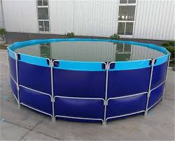
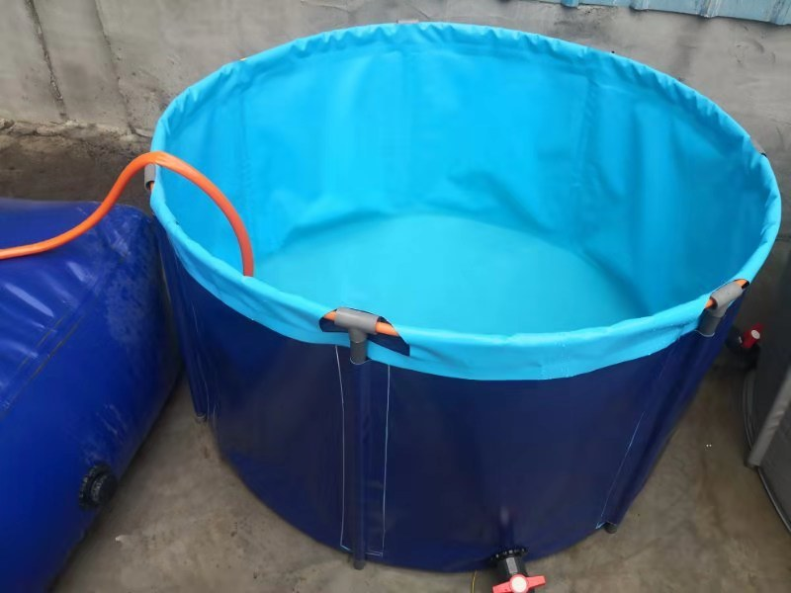
What You Need to Get Started In Fish Farming
1. Secure a Land
Any location is good since fish doesn’t cause any environmental disturbance. Look for a land where you can get it cheap and buy. Depending on the capacity you wants to operate on, a half plot of land is just good enough for an average fish farm.
However, you may go for something bigger like full plot or two if you can afford it probably for convenience sake. If you already have a compound with leftover space you think can accommodate two or three ponds, you may use it.
2. Construct Ponds
You need to engage the service of expert pond construction engineer or you go to another fish farm to get the specification and construction requirements. The plumbing work must be properly done to ensure proper drainage.
Adequate water supply is the lifeblood of fish farm and lack of it may result in disaster because water needs to be changed on a regular interval. Naturally available sources of water such as borehole and river water are the most suitable. Rainwater and tap water from the chemically treated source is not recommended for fish cultivation.
4. Install Overhead Tank
This is the water reservoir from which water is supplied to your ponds. This tank has to be connected to your ponds through the plumbing system to make it convenient for water to flow into your ponds when needed.
5. Get Juvenile Fish
Get your juvenile from another farm that specializes in supplying it. You need to go for the high yield species of catfish or tilapia and make sure you are getting it from a healthy farm.

Slide 18
Feasibility Study for Standard Fish Farming
This feasibility study prepared for a catfish farm capacity of 10,000 and fingerlings of high breed catfish where to be stocked. The expenses from pond construction to marketing is considered. The farm is to have 10 concrete ponds of flow through system and each pond is to contains 1,000 stocked catfish.
Sn | Item | Qty | Unit Price | Amount
1 | Land | 1 | 650,000 | 650,000
2 | Each pond is 3m x 2.5m by 1.4m, each pond consumes 210 blocks and each bag of cement for 30 blocks. Hence 210 x 10 = 2,100 blocks. 2,100/30 = 70 bags of cement needed | 70 | 2000 | 140,000
3 | Trips of Sand | 10 | 7000 | 70,000
4 | 2trips of gravel per Pond | 10 | 64,000 | 640,000
5 | Cost of labour |  |  | 150,000
6 | Cost of plumbing (inlet and outlet facility) |  |  | 100,000
7 | The cost of bore hole |  |  | 150,000
8 | Cost of Treatment |  |  | 50,000
9 | The cost of high breed fingerlings | 10000 | 30 | 300,000
10 | Cost of feeding from day one to maturity stage is 200 bags of foreign feed |  |  | 1,000,000
 |  |  | Total | 3,250,000
When the average weight of the fish is 1.7kg, it will be sold at 800 naira each. The output was 800×9800 fishes, due to 200 mortality. 800 x 9800 = N7,840,000.
Input is N3.25’million.
The profit is N4.59 million after six months of culture.
Following this cost analysis, you can easily invest N3 million and expect good turnover within six months of harvest and sell.
There is no doubt that fish farming is among the list of lucrative businesses in Nigeria. You need to get it right by drawing complete business plan and following it to the later. You need to apply good management skill and follow the acceptable standard. If you do all these, you are sure to make good profit from your fish farming business in Nigeria or anywhere you choose to set it up.
Estimated Cost

